Slide 1
UNIT3-partIII. Hibernate HQL

Slide 2
https://www.tutorialspoint.com/hibernate/hibernate_query_language.htm
https://docs.jboss.org/hibernate/orm/3.3/reference/en/html/queryhql.html
https://howtodoinjava.com/hibernate/complete-hibernate-query-language-hql-tutorial/

Slide 3
HQL properties
Hibernate uses a powerful query language (HQL) that is similar in appearance to SQL.
HQL is fully object-oriented and understands notions like inheritance, polymorphism and association.
Hql is database independent. It can be used with most databases and you don’t need the specific language for the database you try to access.
Case Sensitivity
With the exception of names of Java classes and properties, queries are case-insensitive. So SeLeCT is the same as sELEct is the same as SELECT, but org.hibernate.eg.FOO is not org.hibernate.eg.Foo, and foo.barSet is not foo.BARSET.

Slide 4
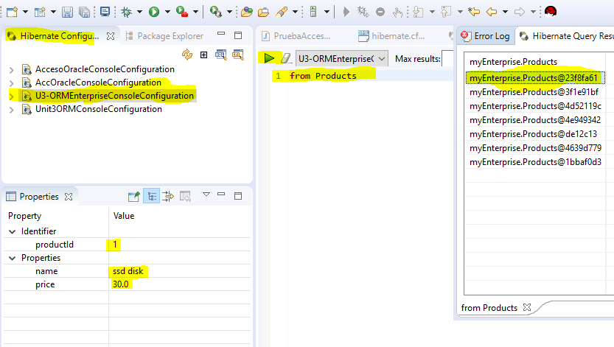
Hql editor: Console Configuration>>Open Hql Editor

Slide 5
The from clause
The simplest possible Hibernate query is of the form:
from myEnterprise.Products
This returns all instances of the class myEnterprise.Products. You do not usually need to qualify the class name, since auto-import is the default. For example:
from Products
In order to refer to the Products in other parts of the query, you will need to assign an alias. For example:
from Products as prod ( from Products prod also works)

Slide 6
The select clause. Examples
Select prod.name from Products prod where prod.name like ‘usb%‘
select p.name from Products p
select p.name from Products p where p.name like 'mouse‘
select p.name from Products p where p.name like 'ddr%‘
select p.price from Products p where p.name like 'ddr%‘
select p.name from Products p order by p.price desc

Slide 7
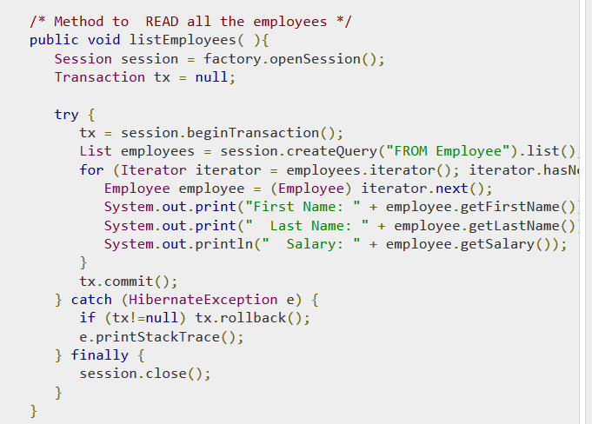
Examples hql (programming)

Slide 8
Class Iterator
Iterator is used to go through a list or collection
It is used in the following way:
List <Person> lpersons = new ArrayList();
lpersons.add(“Juan”);
lpersons.add(“Pepe”);
Iterator it = lpersons.iterator();
while(it.hasNext()){
Person onePerson = (Person) it.next();
}
Also : for(Iterator it=lpersons.iterator();it.hasNext();)

Slide 9
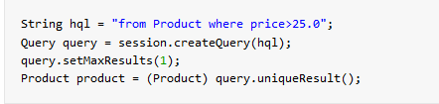
Practice 3.3. hql queries
Methods:
- session.createQuery(hqlSentence): returns a list of objects. You need to traverse the list with the result using an iterator.
- session.uniqueResult(hqlSentence): if there is only one result for the query, you don’t need to traverse all the results with an iterator, because you only have one object returned for the query). Using it, your program is more efficient.
Use it in two cases:
when you only need one result from your query
When you know that there is only one result for your query.
http://www.java2s.com/Code/Java/Hibernate/UniqueResultHQL.htm

Slide 10
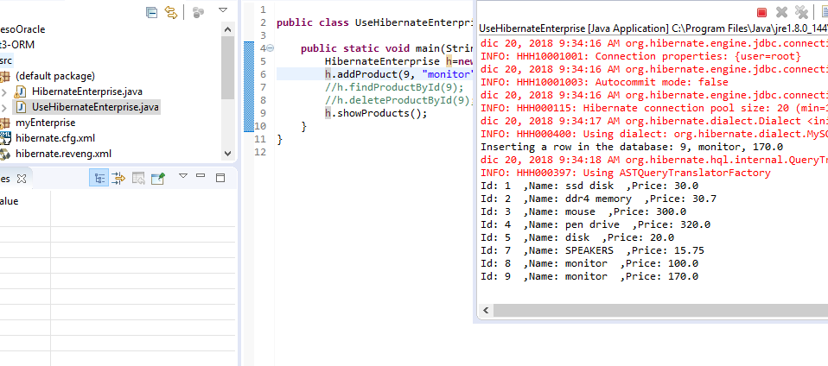
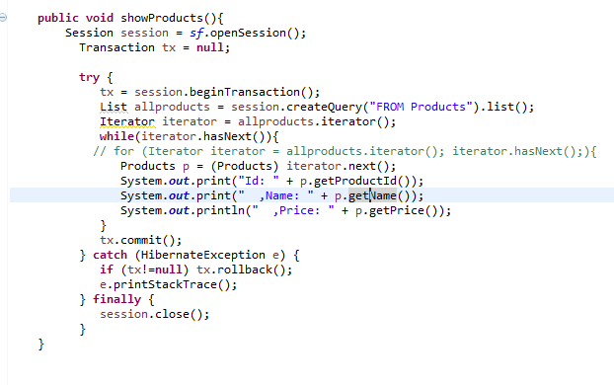
Practice 3.3. programmimg with hibernate hql

